Slide 1
Vivado Tutorial 1 – Behavior Simulation
ISDN 4400

Slide 2
Preface
This is a serial of tutorials telling you how to use Xilinx Vivado Design Tools to do/verifying VLSI design with FPGA. You could also look for official tutorials in Xilinx design hub or seeking help from YouTube.
This tutorial follows Xilinx UltraFast Design Methodology. If you are interesting in doing industrial level FPGA project, you could do an in-depth learning on this methodology.
Tutorial 1 tells you how to setup an Vivado project and do circuit behaviour simulation.

Slide 3
Bookmarks
Vivado download and installation
Create an Vivado FPGA project
Circuit behavior simulation
View block diagram

Slide 4
I. Vivado download and installation

Slide 5
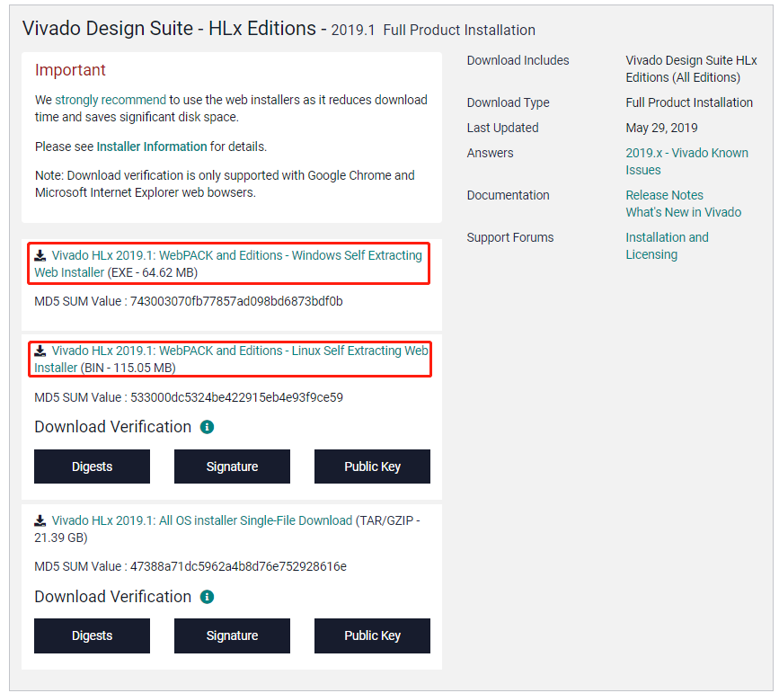
I. Vivado download and installation
Download the latest Vivado Webpack version (free version) from here.
You need to register before download.
MacOS is not supported. If you’re using MAC you may want to install a Ubuntu/Windows virtual environment for that.
Vivado is hard to drive, make sure you use at least a notebook version i5 CPU to run it.

Slide 6
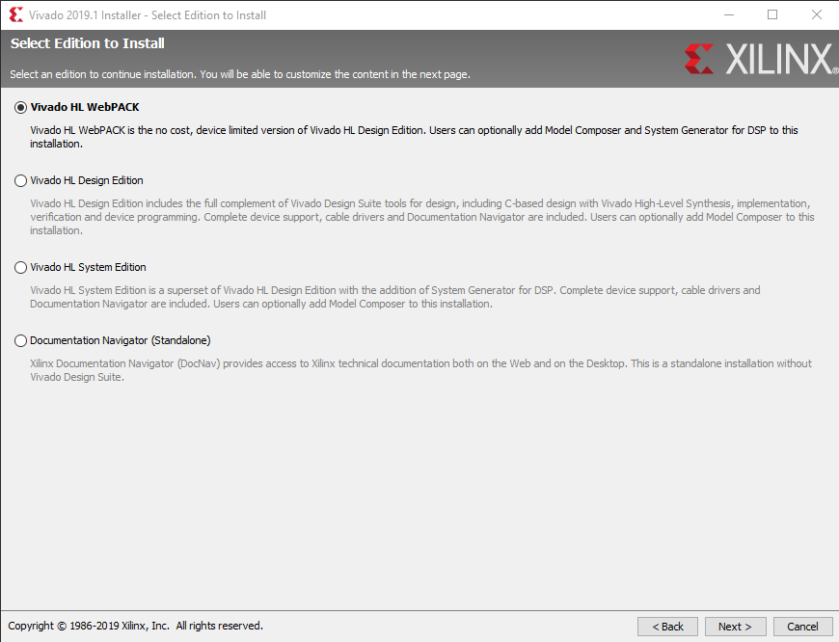
I. Vivado download and installation
For detailed installation flow, please refers to this video, or other videos on youtube.
Vivado requires 40GB disk space.
Please select to install “Vivado HL WebPACK” version. This is the free education version and only limits the device support.
WebPACK supports the FPGA version we use in this class.

Slide 7
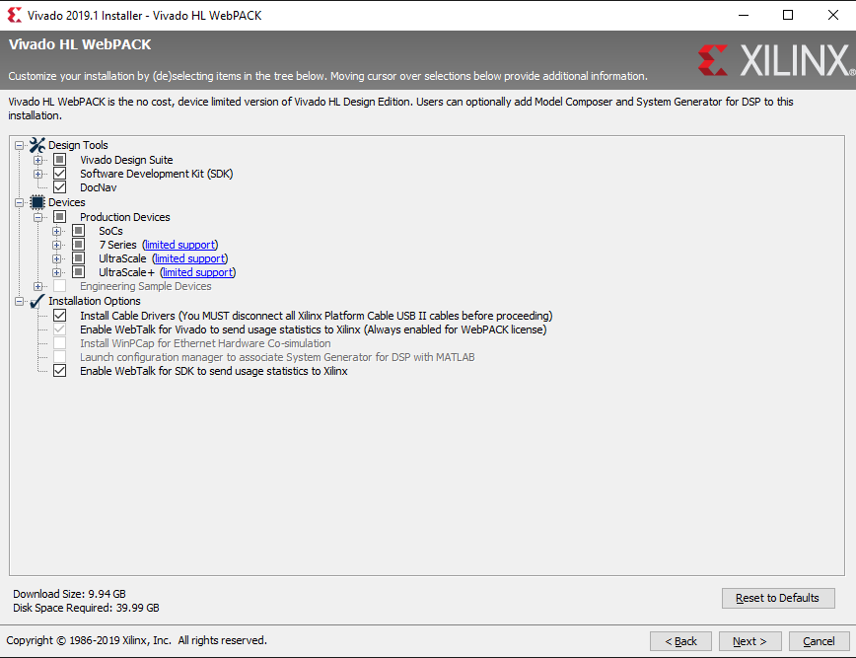
I. Vivado download and installation
Make sure you check everything here
The most important things are SDK, 7 Series Devices and Cable Drivers.
Finish the installation normally.

Slide 8
II. Create an Vivado Project

Slide 9
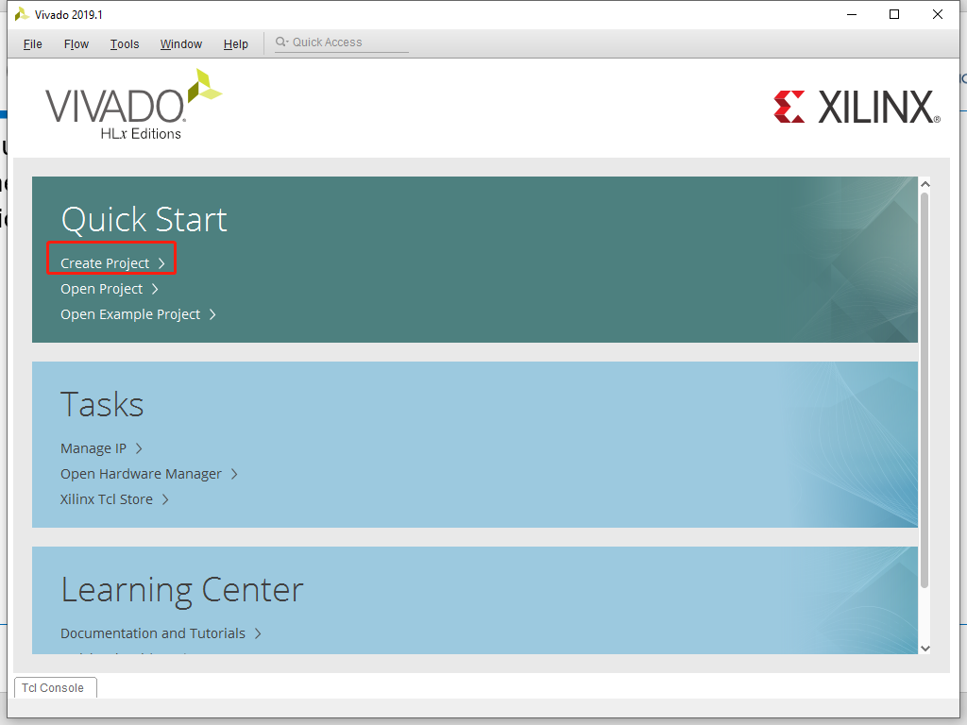
II. Create an Vivado Project
You could find a lot of video tutorials on Youtube, e.g. this video. The major steps are summarized as below.
Click here to create a new project

Slide 10
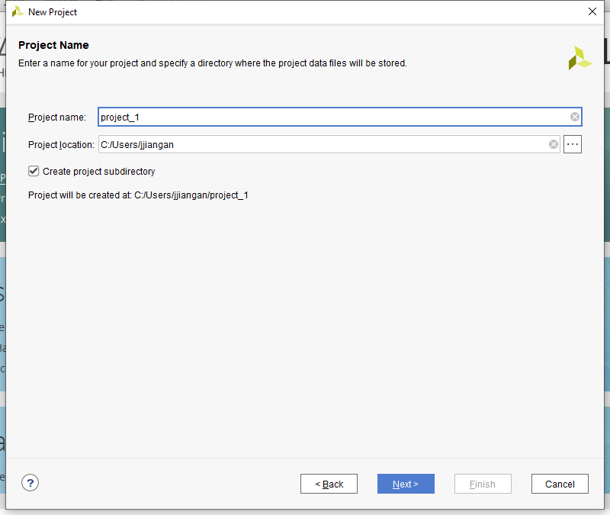
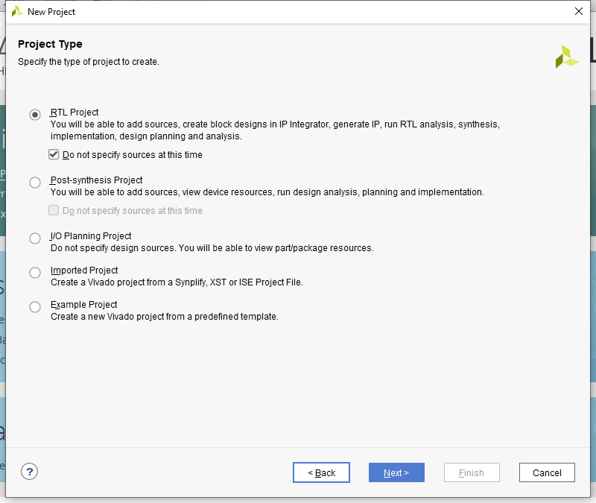
II. Create an Vivado Project
Name your project and choose RTL Project as type.

Slide 11
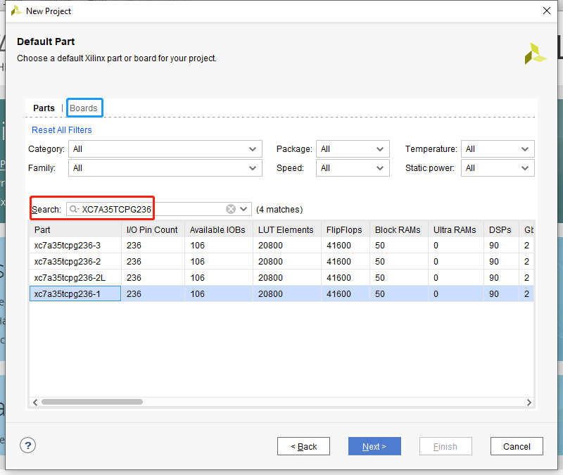
II. Create an Vivado Project
Choose your target device, for this course we are using Artix-7 FPGA xc7a35tcpg236-1.
Note if you have a Xilinx official developing board, like AC701 you can chose it from “Boards”, a large number of configurations like big IPs (e.g.mig-7series for DDR), pin assignment, etc will be automatically finished by Vivado to make your life easier.
After this we’ve set up an empty project.

Slide 12
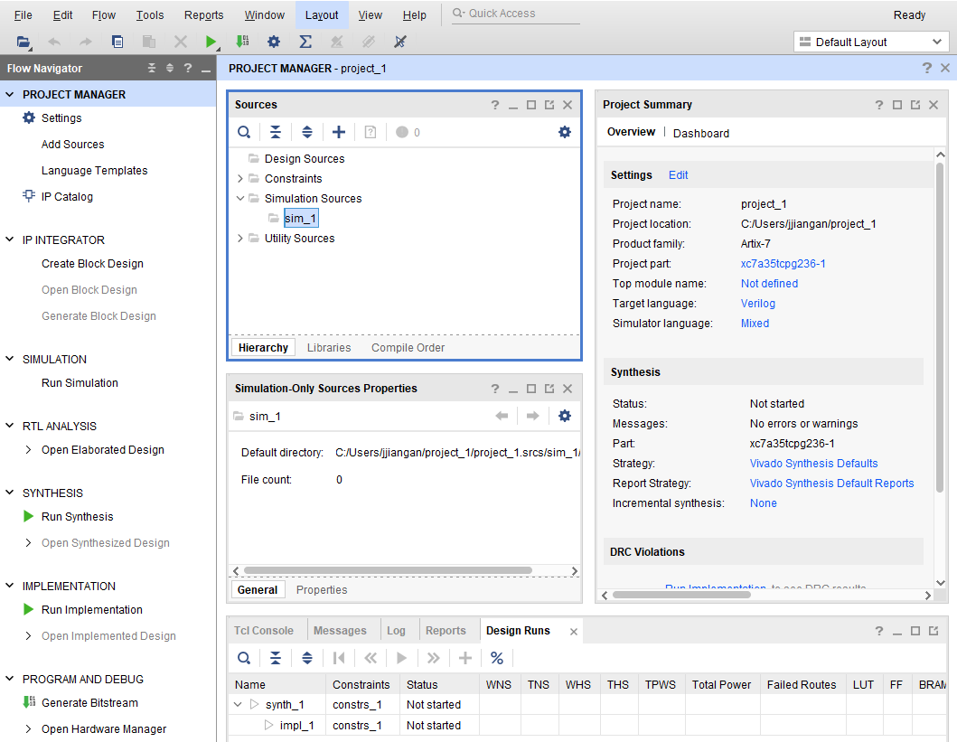
II. Create an Vivado Project
The main GUI is shown here.
Red box shows the top-down approach to finish an FPGA design, this tutorial will only guide you on the steps labelled by the yellow box.

Slide 13
II. Create an Vivado Project
Blue box is to organize your source files
Noted that the best approach to interact with Vivado is to create or copy&add source files using its GUI and let it manage your files automatically in your file system. Else you may end up massing with your folders.
Design Source folder stores all your .v source files. Constraints folder stores all the .xcl constraint files. Simulation Sources folder stores your testbench simulation files.

Slide 14
II. Create an Vivado Project
You may notice that there are multiple cross signs in your project. That is because Vivado will stack a project view directly on another, and allowing multiple project views being opened at the same time.
For example, closs the dark purple cross will close the whole project. But later on if your opened a “simulation” view, the “project manager” view will still there. After you close the simulation view it’ll show up again.
The light purple cross is to close the small windows like the project summary.
This could be reset by Layout -> Reset layout.

Slide 15
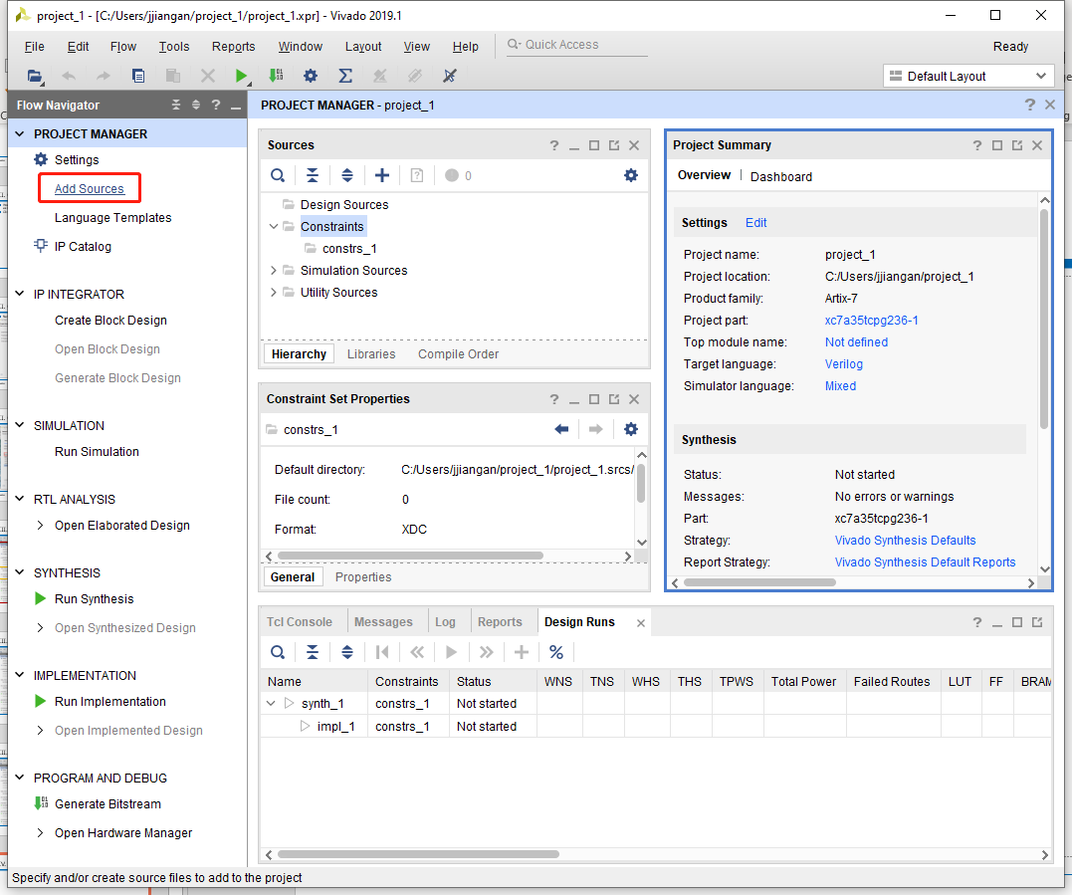
II. Create an Vivado Project
Click Add Sources to add new design files
Chose “Add or create design source”

Slide 16
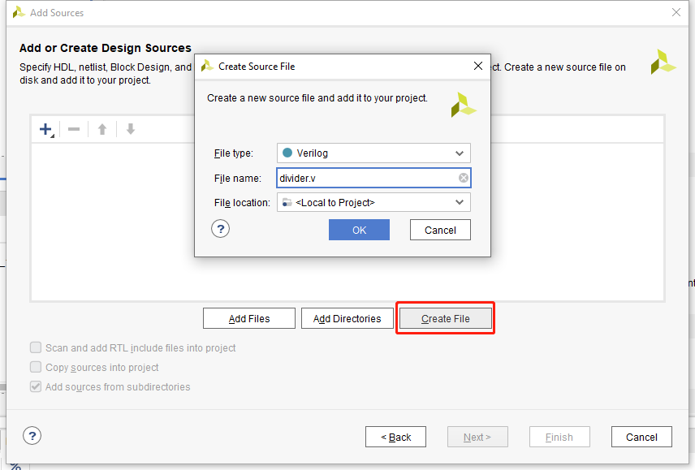
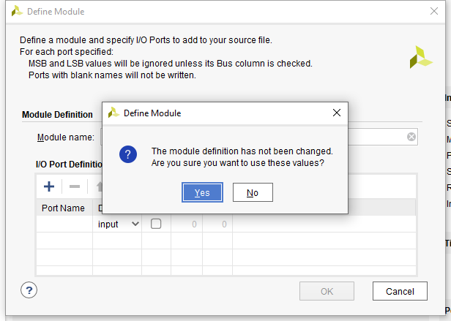
II. Create an Vivado Project
Create a file named divider.v
Skip define module input/outputs by clicking OK follows by clicking Yes.

Slide 17
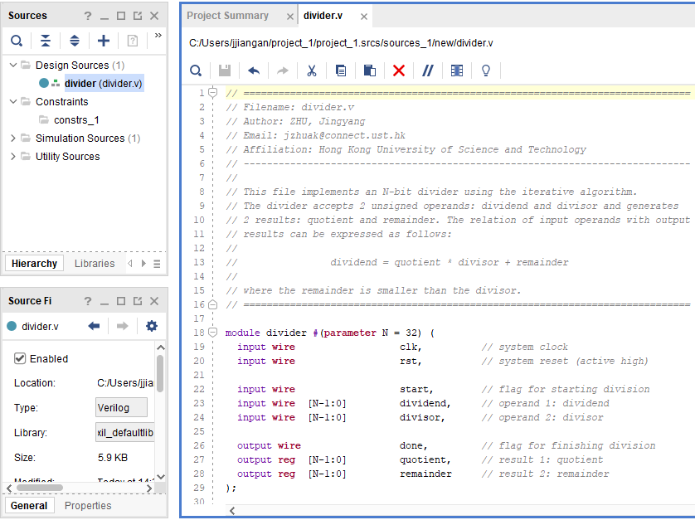
II. Create an Vivado Project
Wait until Vivado finishes auto-managing your file systems.
Open divider.v, copy source code from this Github repository.
Save the divider.v

Slide 18
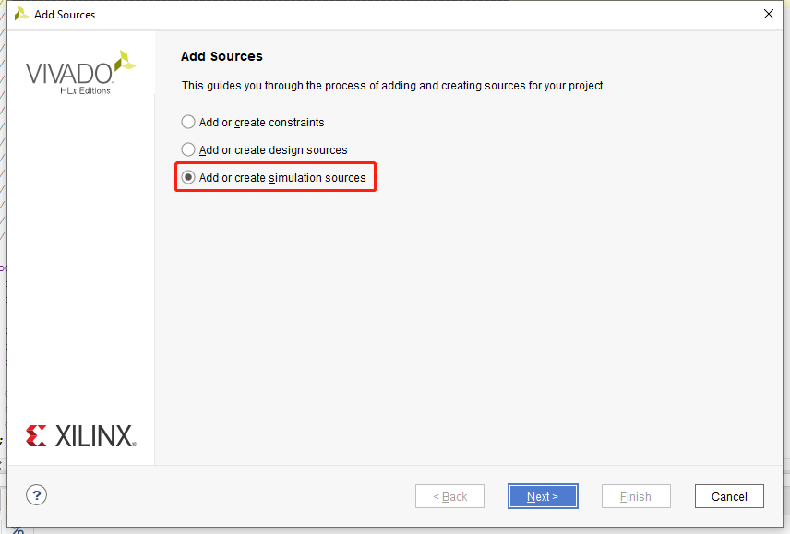
II. Create an Vivado Project
Now we need to add the testbench, which is a .v file that only used for testing
Divider.v is the source file so you need to make sure it’s synthesizable. Testbench do not and normally is not synthesizable, it’s only used for testing your divider.v
Follow the same instruction as you create divider.v, but this time choose “Add or create simulation sources”
Create a file named “divider_tb.v”

Slide 19
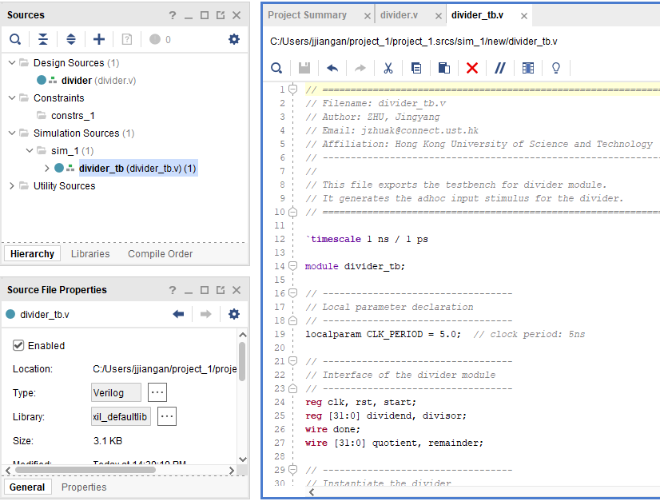
II. Create an Vivado Project
Open divider_tb.v in the Simulation Sources folder
Copy source code from this Github repository.
Note as shown in the Sources windows, the divider under Design Sources and divider_tb under Simulation Sources are all labelled in bold type. This means they are the top design and top simulation sources.
If you have multiple deisgn files or multiple simulation files, you can manually change the top sources by right click on the file (e.g. the checked blue box region) and choose “set as top”
This is very useful skill when you have multiple version of design/ testbench files.

Slide 20
III. Circuit Behavior Simulation

Slide 21
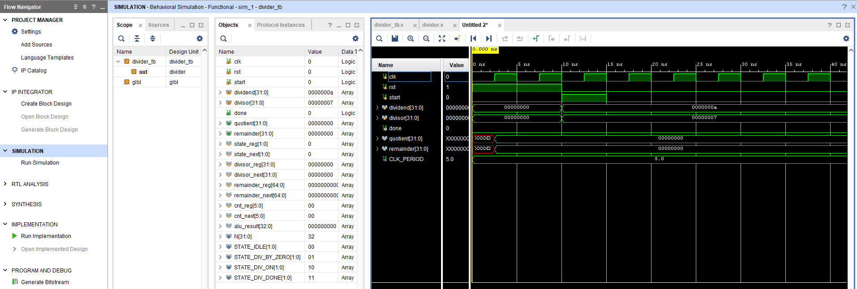
III. Circuit Behavior Simulation
Click on the “Run Simulation” bottom
The blue box part is the wave form. You may notice that the result is not correct. It’s because this is an unfinished divider. If you are interested in it, search “TODO” in divider.v, finish the Verilog code and see what will change in the quotient and remainder signals.

Slide 22
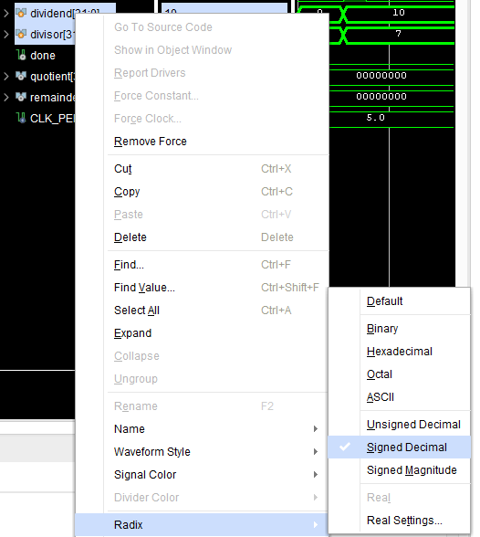
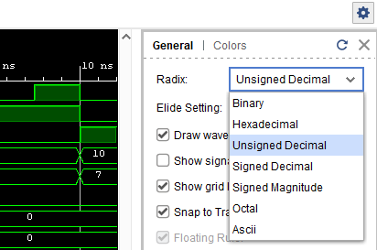
III. Circuit Behavior Simulation
By right click on the selected wave form, you could also change its radix to anything you want.
Here because this function is a decimal divider, so you may want to change the major signals to signed decimal.
You could also change all signals’ radix in the right side bar as shown below.

Slide 23
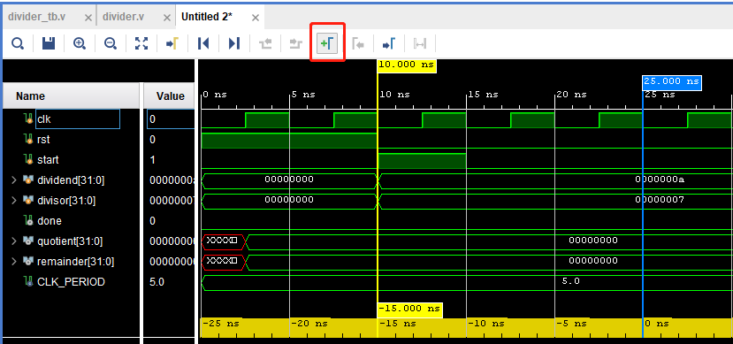
III. Circuit Behavior Simulation
By clicking on add markers, you could also measure the time interval between the two markers.

Slide 24
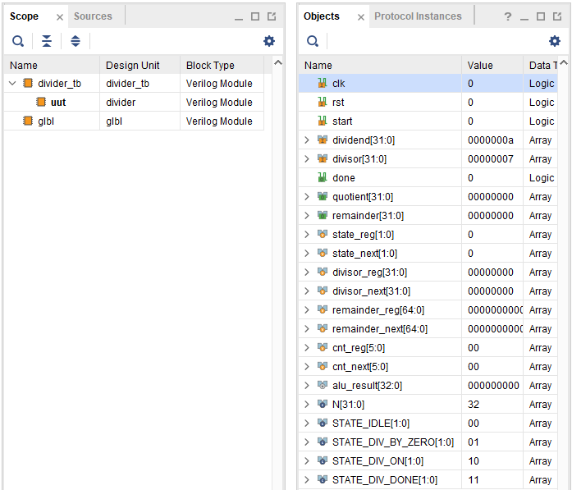
III. Circuit Behavior Simulation
The “Scope” view (red box) let you switch between hierarchical components. The top component here is divider_tb, which is the testbench circuit block. The uut under it refers to the divider, which receives the input from divider_tb. Glbl contains some global variable signals that you can ignore at this stage.
The “Objects” view changes according to the component you selected. Lists all the I/O and internal signals of this components.

Slide 25
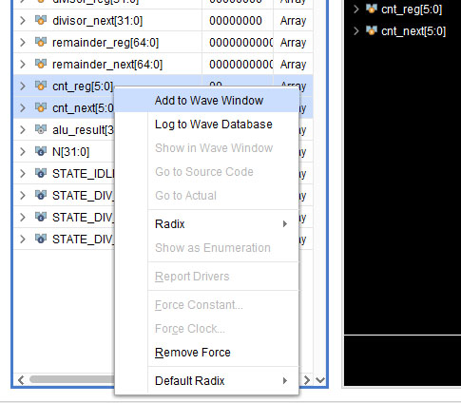
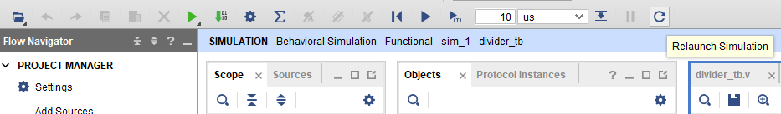
III. Circuit Behavior Simulation
By right click on the signal and chose “Add to Wave Window”, you could view more signal changes in the wave form.
However, the newly added signal is normally un-simulated, so you need to use the “Relaunch Simulation” bottom to run the simulation again to obtain their wave forms.
By pressing “Ctrl+S”, you could save the save form configuration and add it to your project. So next time you run simulation again, all your configurations will be restored. See this answer for more information.

Slide 26
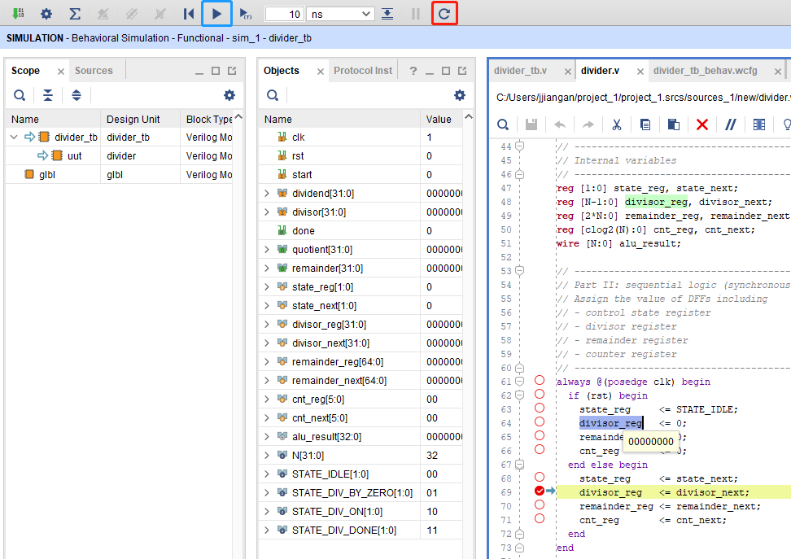
III. Circuit Behavior Simulation
Another very useful skill is you can enable the break point in your source code or testbench.
Note that break point breaks according to the cycles. It’s important to be clear of which part of your code (signals) is dependent (sequential access), which part is independent (parallel access).
Then click on the red box to restart the simulation.
If you want to run to the next break point, click on the blue box.
If you want to run step by step, click on the purple box.
You could view signal values by suspending your mouse onto the signal.
The waveform will be automatically updated.

Slide 27
IV. View Block Diagram

Slide 28
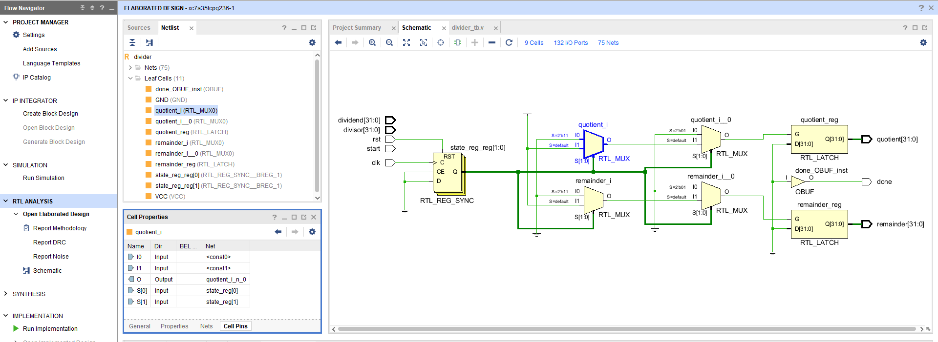
IV. View Block Diagram
RTL Analysis will go through your source code and generate schematics to help you visualize your design logic, which is a very useful tools when you are tuning your design.
Simply click on “Open Elaborated Design” to begin RTL Analysis.

Slide 29
IV. View Block Diagram
The Schematic view (red box) shows the analysed circuit hierarchy. Note this is different from a synthesized schematic, which is constructed by the standard cell library.
The Netlist view (purple box) lists all the components and nets (wires) in the analysed design.

Slide 30
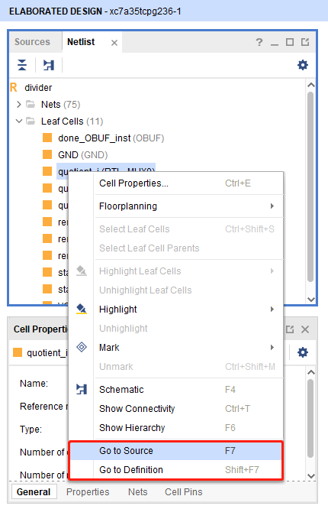
IV. View Block Diagram
You could also right click on the components in the Netlist view to go to source. This will helps you to understand which line of your code makes Vivado analysis your circuit structure in the way it presents to you.
You could also show connectivity, hierarchy, or highlight this components on the schematic. You could play around with these options to get familiar with them if you are interested in it.
Also you could right click on the components/nets on the schematic view, it’s the same.

Slide 31
IV. View Block Diagram
The Cell Properties view (blue box) changes when you click on the net/components on the schematic. It tells your more information like input/output, or connecting nets about the things you selected.

Slide 32
Thank you
This is the end of this tutorial

